Slide 1
Event Driven Programming
Lecture 1
Introduction
C# Control Statement

Slide 2
Outline
1. Introduction
What's event driven programming?
Visual basic.Net
.Net framework
Visual Studio 2008
Building Your First Application
2. Conditional Statements
3. Loops

Slide 3
What is event driven programming?
Before Defining event driven programming, we must first know what events are?
Events are the actions that are performed by the user during the application usage.
Examples
Clicking a mouse button
moving the mouse
Pressing a Key down/up
Encountering messages from other programs or thread

Slide 4
Event driver programming…?
Event driver programming (which is also called event-based programming ) is any programming language, which uses these events to run a specific portion of the program.
Other definitions
It is a programming paradigm in which the flow of the program is determined by events.
Event-driven programming is an application architecture technique in which the application has a main loop which is clearly divided down into two sections:
the first is event selection (or event detection), and
the second is event handling

Slide 5
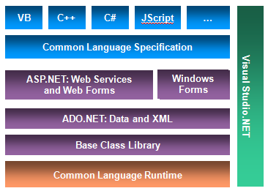
What is .NET framework
The MS .NET Framework is a software framework that can be installed on computers running Ms windows operating systems.
The .NET Framework provides an unprecedented platform for building Windows, web, and mobile applications with one or more languages.
Event-driven Programming

Slide 6
Visual Studio
Visual Studio .NET is Microsoft’s Integrated Development Environment (IDE) for creating, running and debugging programs (also called applications) written in a variety of .NET programming languages.
This IDE is a powerful and sophisticated tool for creating business critical and mission-critical applications.
Prior to beginning Visual Basic .NET installation, you should make some preliminary checks first.
You must verify that you meet the system requirements for installation. (free hard disk space, RAM size and etc)
Platform

Slide 7
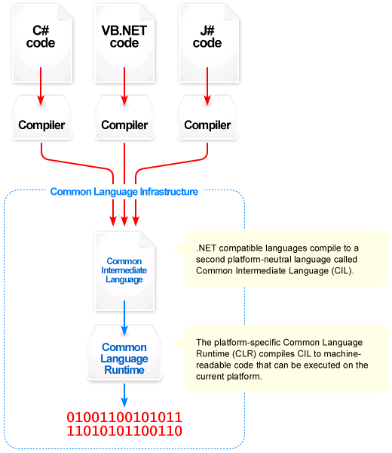

Slide 8
C# programming
Project solution
Project 1
Project 2
Form2
Form1
Text Box
Button
Picture Box
Text Box
Drop down Box

Slide 9
Forms and Controls
Forms and Controls are referred to as OBJECTS
Controls are user interface elements (text boxes, commands) in the Form
Form
You create a form that is your graphical user interface
Has Main method
Has places to input values
Has buttons to click
Has other user interface elements, e.g. Menu, scroll bar…

Slide 10
Objects in C#
Everything in C# is an object such as forms, buttons,…
Three elements of objects.
Properties: Attributes that describe the object
Events: Characterizes how an object can respond
Methods: Defines actions an object can take
A method may or may not return a result when called
Each time you add a control to a form (like a button or text box), you create instances of the class represented by those controls. Those controls are considered as an objects.
C# object
Properties (size,
Caption…)
Methods (Print…)
Event Handler
(Command1_Click())

Slide 11
Object: Dog
Properties
Height, weight, color, emotion (friendly, hostile)…
Methods
Barking, biting, wagging, singing…
Event handlers
Event: Owner coming in: call wagging, call singing,
Event: Intruder coming in: call barking, call biting,

Slide 12
Common Form Controls (Objects)
Buttons
Text Box
Labels
Radio Buttons
Check Box
Combo Box
List Box
Numeric Up Down

Slide 13
Common Control Properties
BackColor
Enabled
ForeColor
Location
Name
Size (Height, Width)
Text
Visible

Slide 14
Common Events
Click
Enter
TextChanged
KeyDown
MouseEnter
MouseLeave
MouseHover
SelectedIndexChanged

Slide 15
Lecture 2

Slide 16
Variable and Conditional Statements
Variables
Constants
Data Types
Conditional Statements
if
if … else
if … else if
switch

Slide 17
Variables
Variables are locations in the computer’s memory where values can be stored for use by a program.
All variables must be declared before they can be used in a program.
Visual C# variable declaration has the following format:
type varoable_Name; where
Variable_Name is the name of a variable
Type refers the type of the variable whether it is integer, string, or …
E.g int num;

Slide 18
Variable Initialization
Variable initialization is the process of assigning a value to a variable.
Variables should be declared before a value is assigned to it.
Examples:
response = "The answer“;
String response = "The answer“;
bLearned = true;
oObjectVar = New Something();
x =5;
Memory locations that hold data that cannot change during execution are called constants.
Declaration of constants is the same as declarations of variables except the keyword const is added at the beginning of the deceleration.
Example:
Const double discount_Rate = 0.15

Slide 19
Naming Convention
Consist of letters, digits, and the underscore character (_)
Must begin with a letter or underscore
Reserved words are not allowed to be a variable name
C# is case sensitive
NUMBER is not the same as number
Arithmetic Operators in Visual C#
Addition: +
Subtraction: -
Multiplication: *
Division: /
Modulus: %
Increment: ++
Decrement: --

Slide 20
Scope and lifetime of variables
A variable may exist and be visible for an entire project, for only one form, for only one procedure. The visibility of a variable is referred to as its scope
Local variables
global variables
The lifetime of a variable is the period of time that variable exists.
The life time of a local variable is normally one execution of the procedure

Slide 21
Data Types
Data Type | Size (bytes)
Byte | 1
Short | 2
Integer | 4
Long | 8
Single | 4
Double | 8
Char | 2
String | 10 + 2 Per character
Boolean | 2
Date | 8
Value Types Size (in bits) Range sbyte 8 -128 to 127 byte 8 0 to 255 short 16 -32768 to 32767 ushort 16 0 to 65535 int 32 147,483,648 to 2,147,483,647 uint 32 0 to 4294967295 long 64 -9223372036854775808 to 9223372036854775807 ulong 64 0 to 18446744073709551615 char 16 0 to 65535
bool 8 true, false
enum types and struct types ,
Reference types include class types, interface types, delegate types, and array types Pointer types

Slide 22
Question
What should be considered to determine data type of variables? What is the preferred data type of variables that is intended to hold the following data?
Age
Average grade point
Salary
Population
Department
Passed
Promoted
Avogadro number

Slide 23
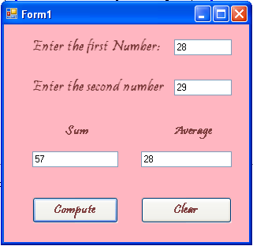
Example
Write a visual basic program which takes two numbers as input and computes their sum and average of the two numbers.

Slide 24
Example…
Double click on compute button and write the following code
int num1,num2;
num1 = Convert.ToInt16(firstTextBox.Text) ;
num2 = Convert.ToInt16 (secondTextBox.Text);
sum = num1 + num2;
average = sum / 2;
sumTextBox.Text = sum;
averageTextBbox.Text = average;
Double click on Clear button and write the following code
firstTextBox.Clear();
secondTextBox.Clear();
sumTextBox.Clear();
averageTextBox.Clear();
Another option to clear a content of a text box is
firstTextBox.Text = ““;
secondTextBox = “”

Slide 25
Conditional Statements
Conditional statements evaluates a condition and produces a true or a false Boolean value in order to control the flow of code.
VB.Net has the following conditional statements
if – single selection statement
if … else – double selection statement
if … else if multiple selection statement
switch – multiple selection statement

Slide 26
if – single selection statement
The simplest control statement—and one that is common to almost every programming language—is the If statement.
This statement has several different formats but basically it looks like this:
Basic Syntax: if (boolean expression) { statements }
The <condition> is the key part of this statement
it determines whether or not the inner block of code is executed.

Slide 27
if … else – double selection statement
The if…else selection structure allows the programmer to specify that a different action (or sequence of actions) be performed when the condition is false.
Syntax:
if <condition> statements
else
else statement
E.g.
if mark>60
MessageBox.Show(“Excellent”);
Else
MessageBox.Show(“good”);

Slide 28
if … else if multiple selection statement
Generally, If…Then…Else Conditional Statement has the following structure
if <condition> { statements
} else if <condition> { elseif_statements
} else{ else_statements
}

Slide 29
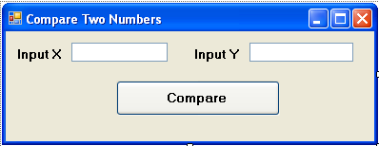
Example1
The following application takes two numbers and returns larger number
int firstnum;
int secondnum;
firstnum = Convert.toInt32(txtInput1.Text)
secondnum = Convert.toInt32(ttxtInput2.Text)
if firstnum > secondnum
MessageBox.Show(" X is greater than Y ")
else if firstnum < secondnum
MessageBox.Show("X is less than Y")
else
MessageBox.Show(" X is equal to Y")

Slide 30
Example2
Write visual basic . Net windows application that takes result of a student out of 100 and assigns letter grade to the input value based on the following scale.
100>X>90----------------->A
90>X>70------------------->B
70>X>50------------------->C
50>X>40------------------->D
40>X>0--------------------->F
>100 and <0-------------->Invalid Input

Slide 31
switch – multiple selection statement
The switch statement Replaces multiple if .. else statements
Syntax:
switch ( expression ){
case value1 statement; break;
case value2 statement; break;
// etc.
default statement;
}

Slide 32
switch ( age ) {
case 13 : textBox1.Text = "you are a teenager"; break ;
case 18 : textBox1.Text = "you can vote"; break ;
case 21 : textBox1.Text = "congratulations"; break ;
default : textBox1.Text = "You are not 13, 18 or 21.";
break ;
}
Note the break statement – it must be there
you can only continue to the next statement if it is empty
case 1 :
case 2 : textBox1.Text = "executed for case 1 or 2"; break ;

Slide 33
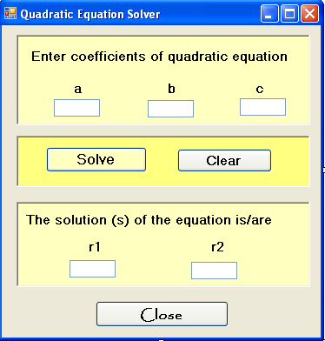
Exercise
Develop vb.net application that solves quadratic equation. The user interface of the application should look like the one on the right

Slide 34
C# Loops
Loops
for loop
foreach loop
Do loop
break and continue statements

Slide 35
For loop
Used when you know the details of the loop
the start, increment and end values
for (variable = start_expr; end_expr;incr_expr) {
statement(s);
}
Example
for (int count = 1; count <= 10; count++){
listBox1.Items.Add(count +" times 2 is "+count*2);
} // end of for loop

Slide 36
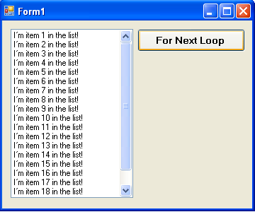
Example
The following code adds lists in the list box shown below
int i;
for(i = 1; i<10;i++)
firstData.Items.Add("I’m item " + i.ToString + " in the list!");

Slide 37
foreach Loop
A variation of the For loop, the foreach loop scans through a set of related item from the first item until the last.
E.g : Arrays and collection
Syntax:
foreach(var type Var In Array or Collection ){
statements to be repeated ;
}
E.g.
string[] arr = new string[4]{"one”,"two”,"three”,"four”};
// Loop over strings
foreach (string s in arr) {
firstData.Items.Add(s);
}

Slide 38
The while loop
Used to change counter by different amount or
test within the loop
Syntax:
while (expression) {
statement(s)
}
The statement(s) are executed while expression is true.
Expression is evaluated at the beginning of the loop.
The do-while loop
Similar to while loop
Expression is evaluated at the end of the loop.
Syntax:
do{
statement(s)
}
while (expression); // Note semicolon
The statement(s) are executed at least once.

Slide 39
The do-while loop
The do-while loop
Similar to while loop
Expression is evaluated at the end of the loop.
Format:
do
{
statement(s)
}
while (expression); // Note semicolon
The statement(s) are executed at least once.

Slide 40
break statement
break statement
break statement exits the loop that contains the statement
Continue statement
Allow us to go to the next iteration with out executing codes after continue statement but inside a loop.

